Slide 1
Care Website
(Semester: DISM)
Batch Code: 2211B2
Faculty: Miss Bakhtawar Siraj
Co-Ordinator: Miss Munazzah Khan
Curriculum code: 7062

Slide 2

Sides/Panels of Website
Admin Panel
Doctor Panel
User Side

Slide 3
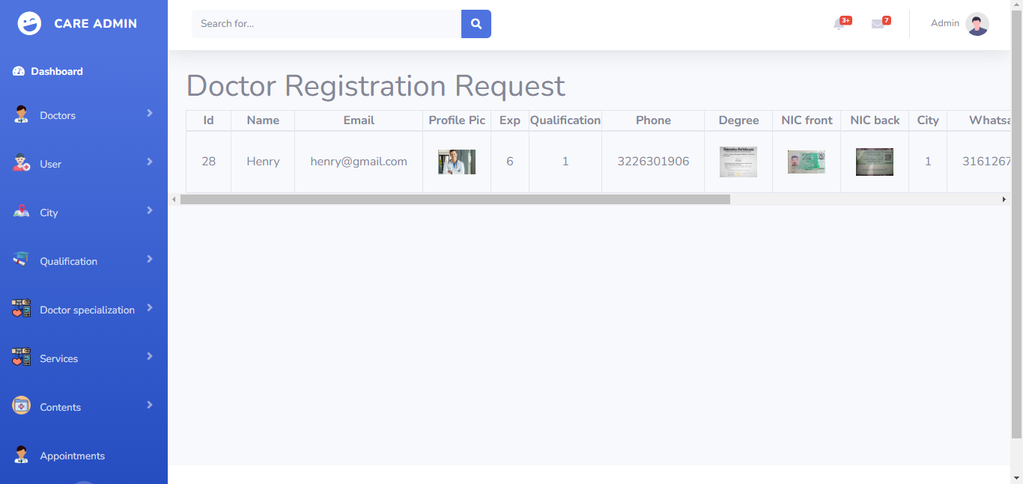
Admin -> Doctor Registration Request

Slide 4
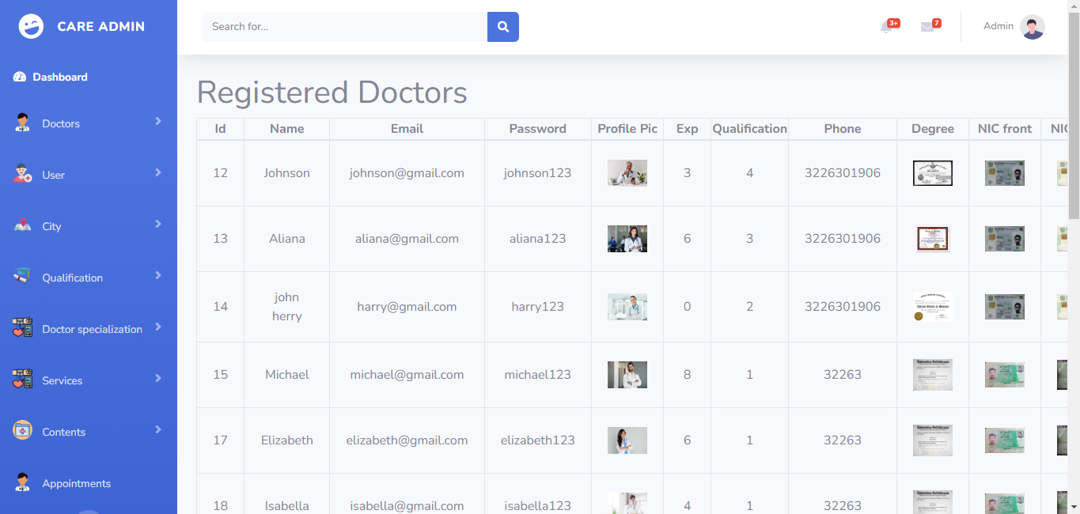
Admin -> Registered Doctors

Slide 5
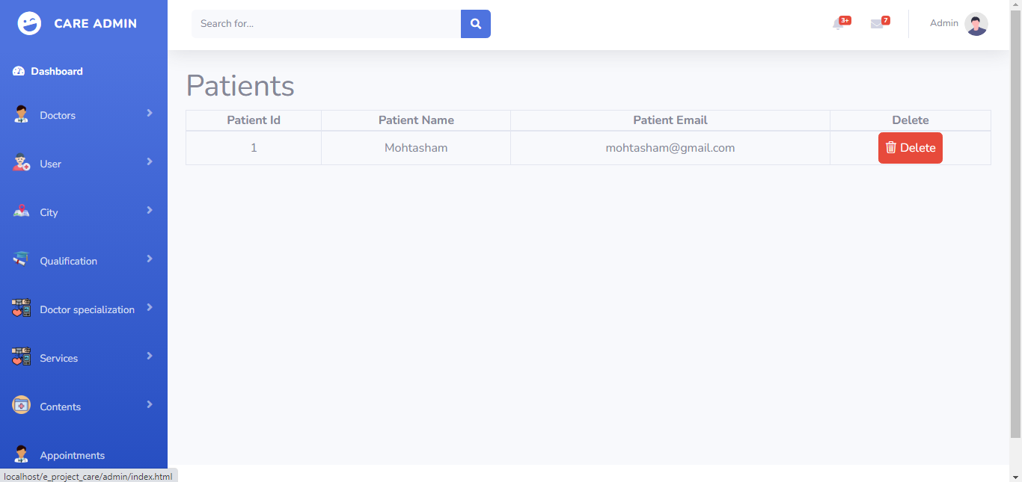
Admin -> Registered Patients

Slide 6
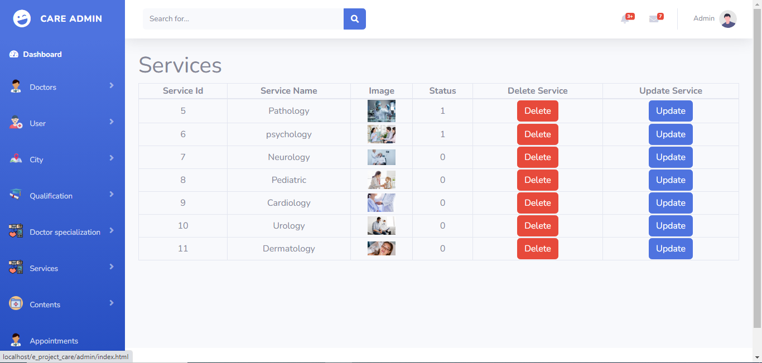
Admin -> Our Services

Slide 7
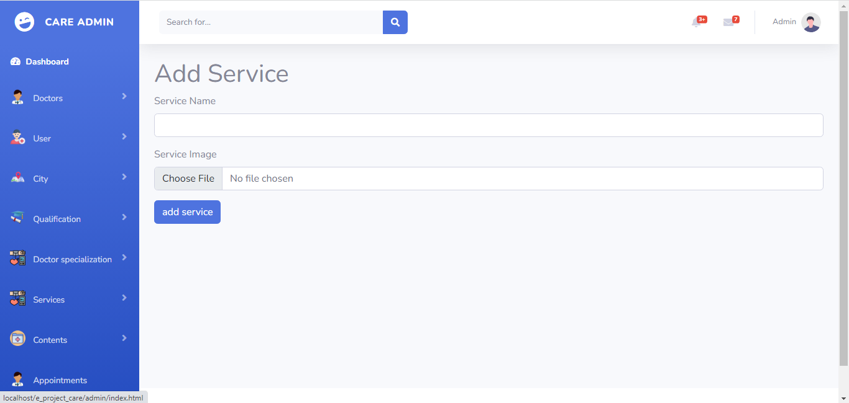
Admin -> Add Service

Slide 8
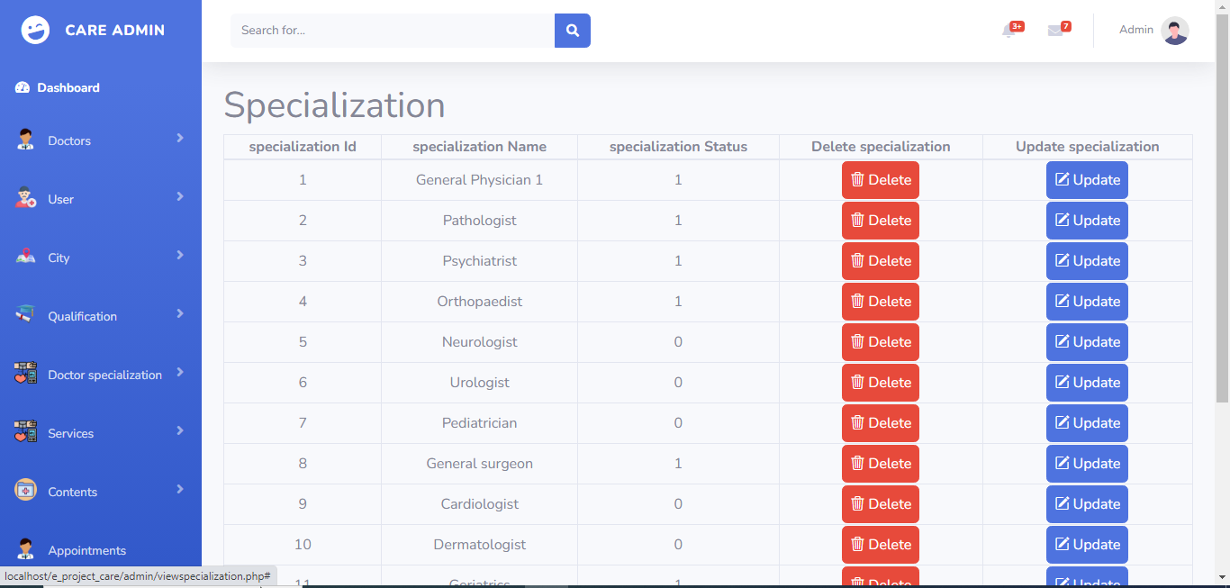
Admin -> Doctor Specialization

Slide 9
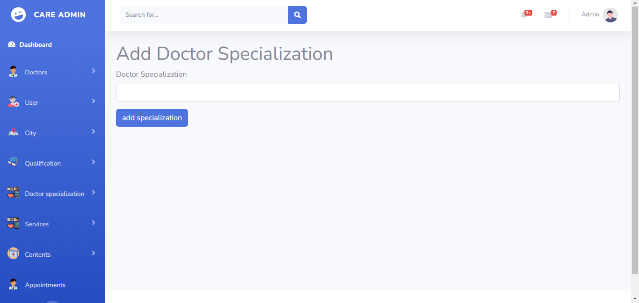
Admin -> Add Specialization

Slide 10
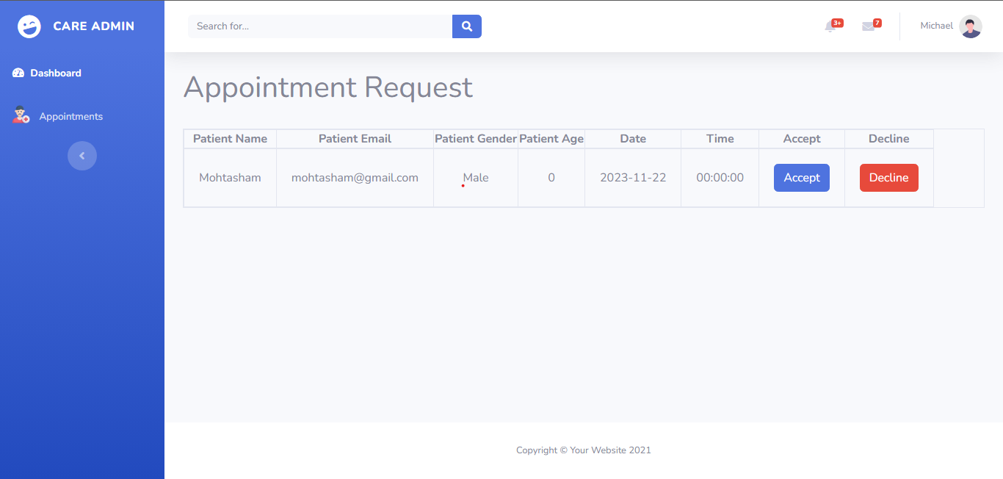
Doctor Panel -> Appointment Request

Slide 11

User Side -> Before Login

Slide 12

User Side -> After Login of User

Slide 13

User Side -> After Login of Doctor

Slide 14
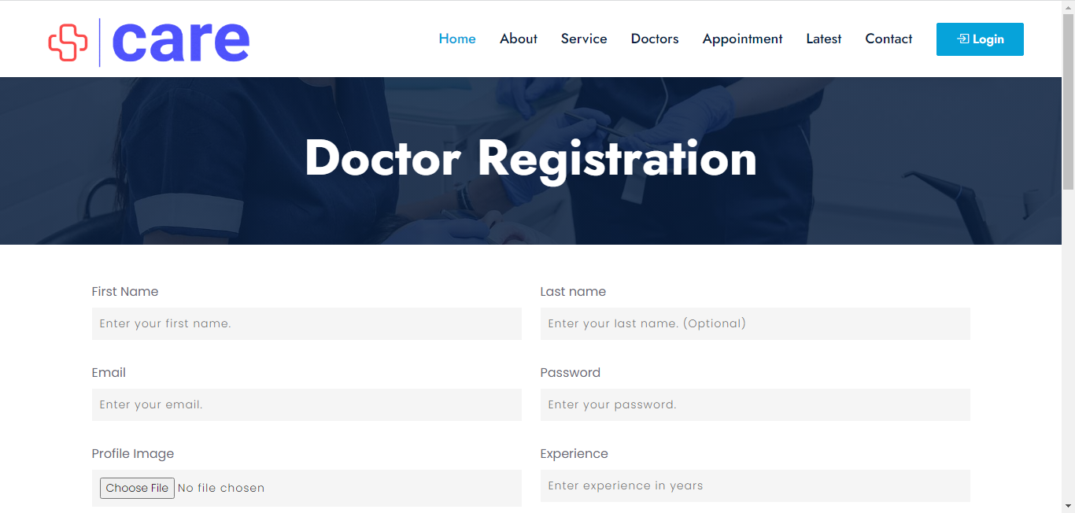
User Side -> Doctor Registration

Slide 15
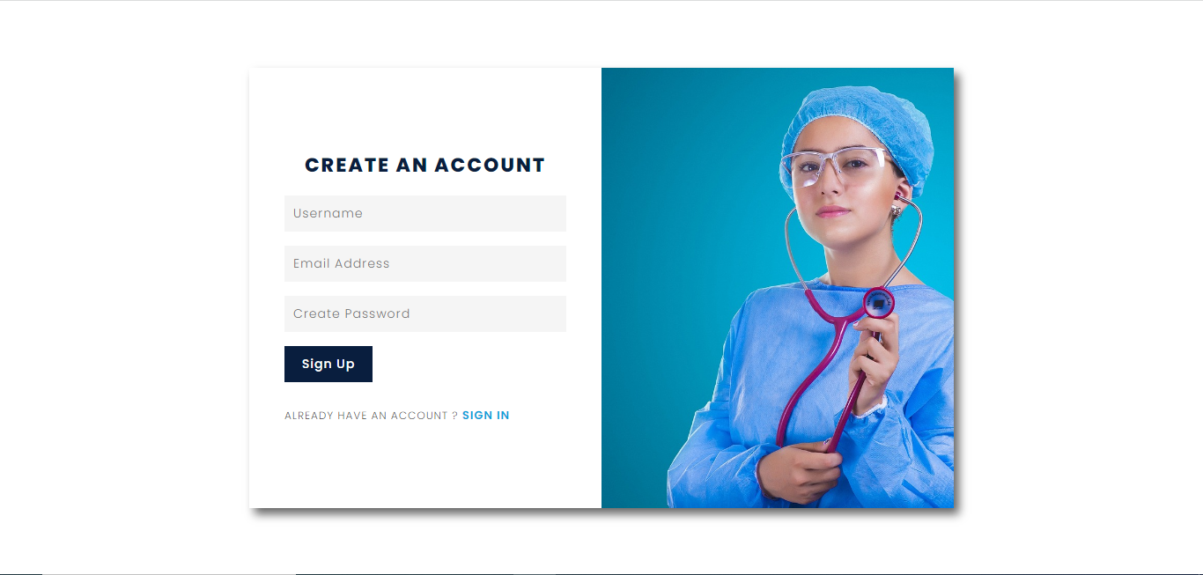
User Side-> Patient Sign Up

Slide 16

User Side -> Our Doctors

Slide 17
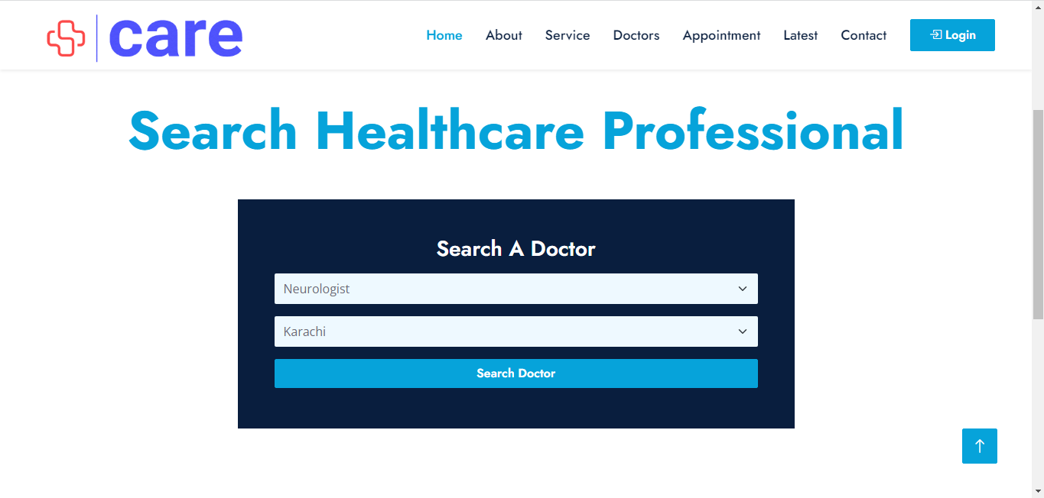
User Side -> Search Doctor

Slide 18
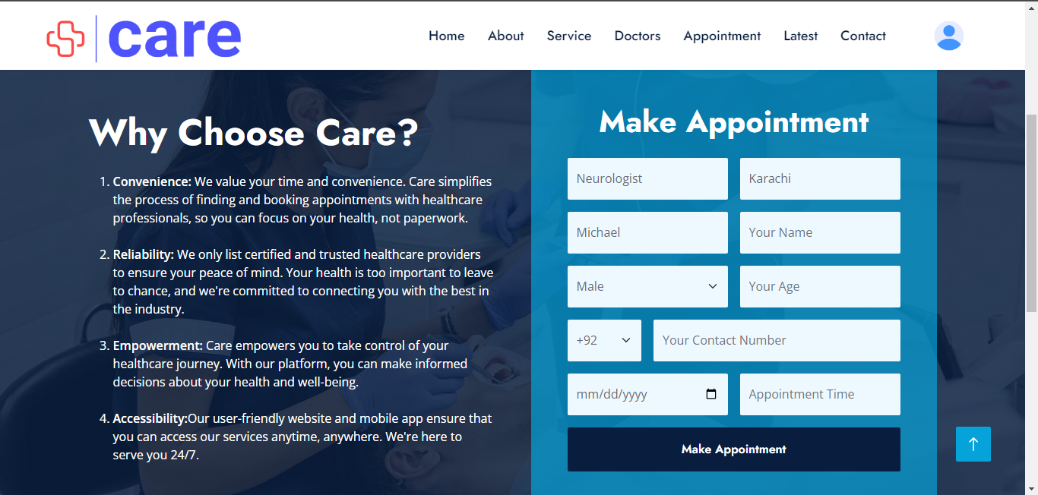
User Side -> Make Appointment

Slide 19
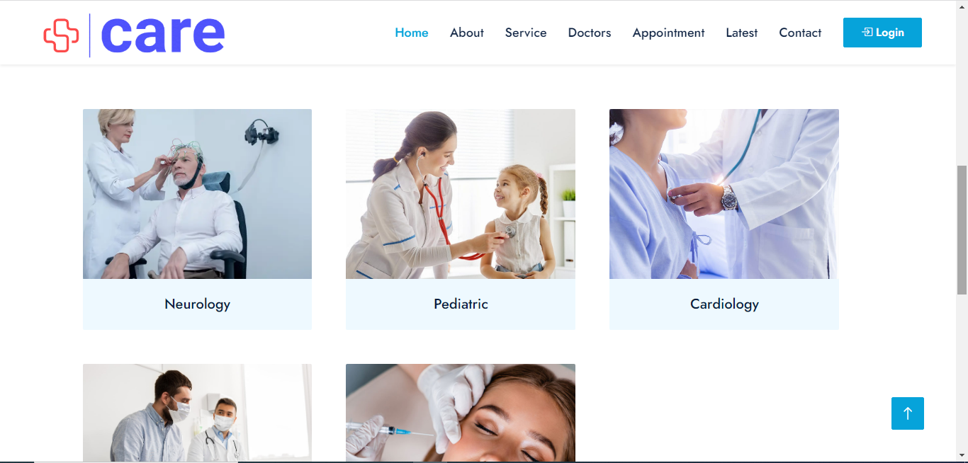
User Side -> Our Services

Slide 20
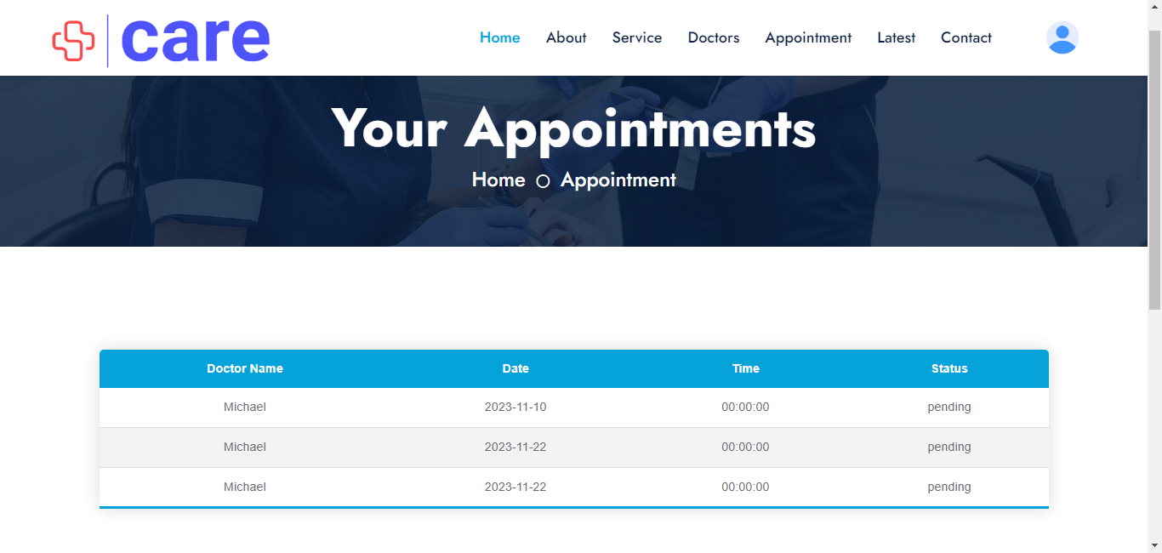
User Side -> Appointment Status

Slide 21
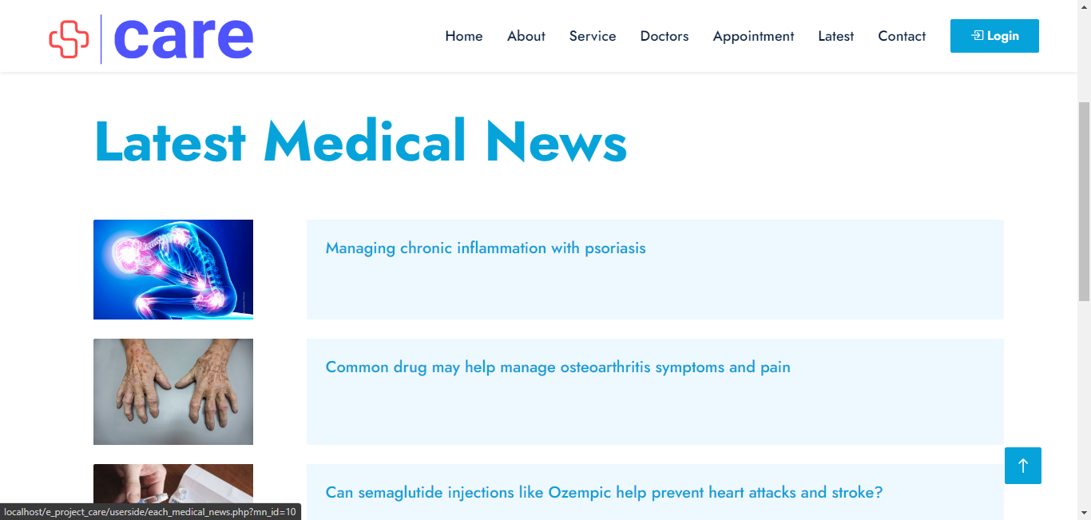
User Side -> Medical News

Slide 22
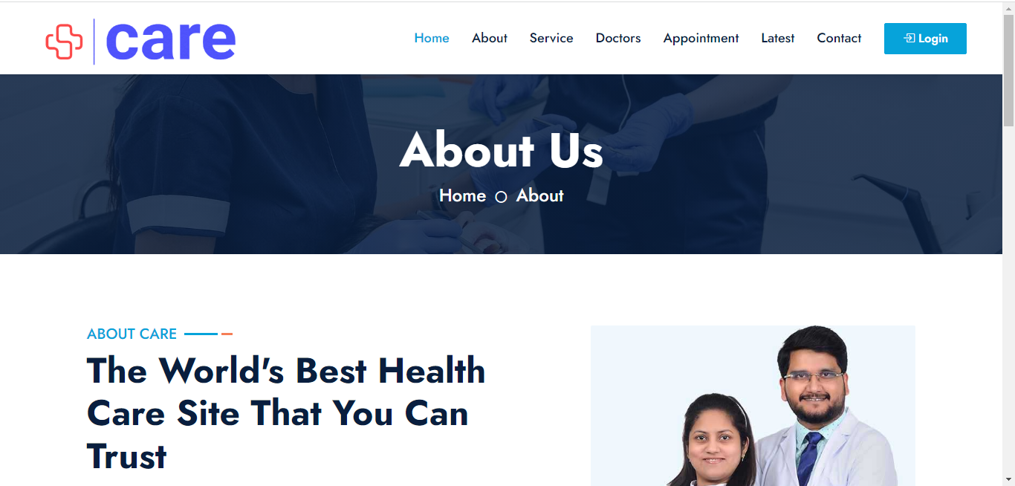
User Side -> About Care

Slide 23
Thanks

